Slide 1
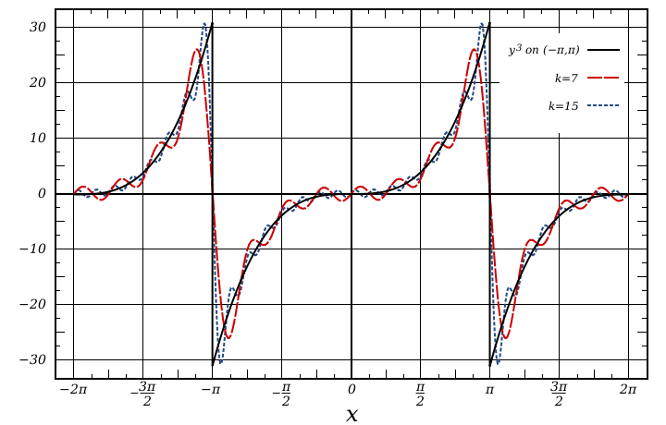
MAT 350 Engineering Mathematics
Fourier Series
and Fourier Transformation
Lecture: 10
Dr. M. Sahadet Hossain (Mth)
Professor
Department of Mathematics and Physics, NSU.

Slide 2
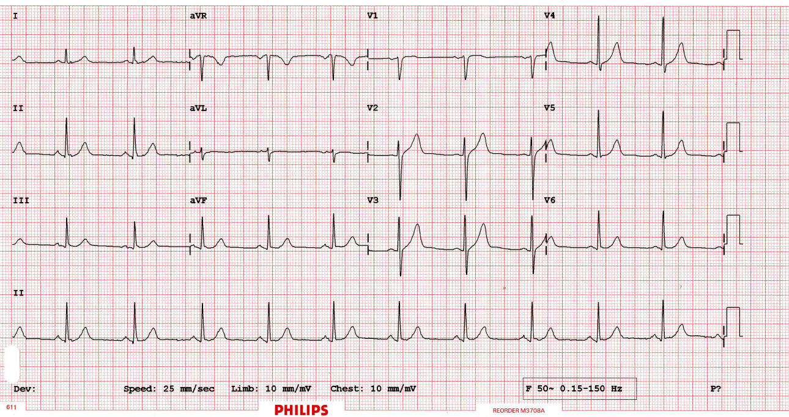
Introduction:
The central starting point of Fourier analysis is Fourier series. They are infinite series designed to represent general periodic functions in terms of simple ones, namely, cosines and sines.
In a digital age, the discrete Fourier transform plays an important role. Signals, such as voice or music, are sampled and analyzed for frequencies. An important algorithm, in
this context, is the fast Fourier transform.
https://www.intmath.com/blog/mathematics/math-of-ecgs-fourier-series-4281

Slide 3
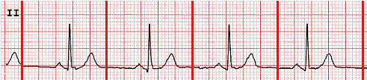
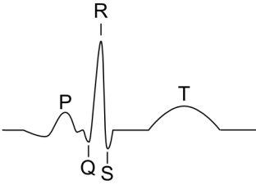
Modeling the Heartbeat Using Fourier Series
A heartbeat is roughly regular (if it isn't, it indicates something is wrong). Mathematically, we say something that repeats regularly is periodic.
Such waves can be represented using a Fourier Series.
Apparently (according to the doctor), this ECG indicates my heart is quite healthy

Slide 4
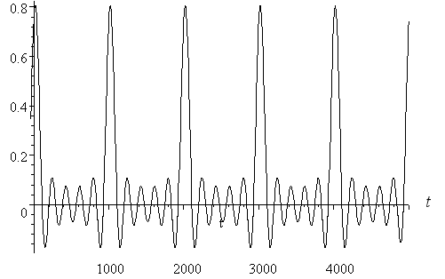
Modeling the Heartbeat Using Fourier Series
Assumptions
In my case, my heart rate was about 70 beats per minute. For the sake of simplicity, I'll assume 60 beats per minute or 1 per second. So the period = 1 second = 1000 milliseconds. A sample mathematical model ca be as follows:
f(t) = - 0.0000156(t − 20)⁴ + 2.5
f(t) = f(t + 1000)

Slide 5
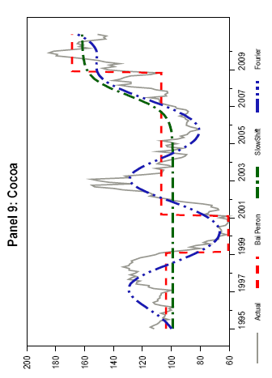
Modeling the behavior of real commodity prices over a finite period using Fourier Series
Approximation of Primary Commodity Prices
Figure: Commodity Prices, Actual Values and Shifting Means Obtained by Various Methods, 1995–2010

Slide 6
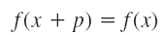
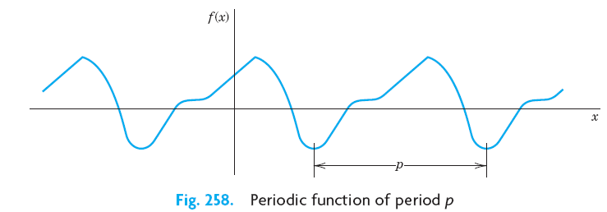
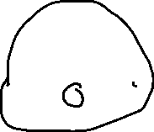
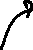
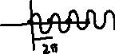
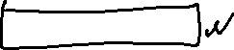
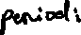
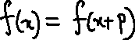
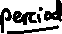
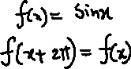
Fourier Series
Preliminaries:
A function f (x) is called a periodic function if f (x) is defined for all real x, except possibly at some points, and if there is some positive number p, called a period of f(x), such that
(1)
for all x.
(2)

Slide 7
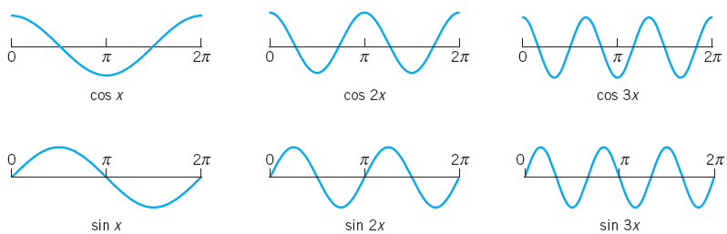
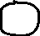
Periodic Function:
(2b)
All these functions have the period . They form the so-called trigonometric system.

Slide 8
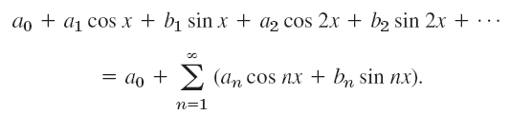
A trigonometric series is a combination of constant, sine, and cosine, as follows
(3)
We see that each term has the period 2π. Hence if the coefficients are such that the series converges, its sum will be a function of period 2π.

Slide 9
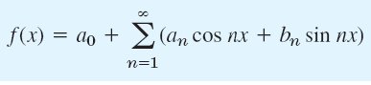
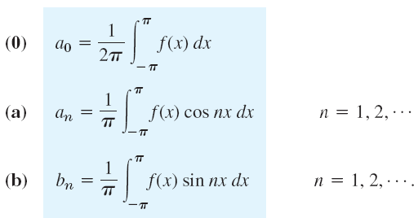
Now suppose that f(x) is a given function of period and is such that it can be represented by a series (3)
(4)
Equation (4) is called the Fourier series of f(x).
The coefficients of (4) are the so-called Fourier coefficients of f(x), given by the Euler formulas
(5)

Slide 10

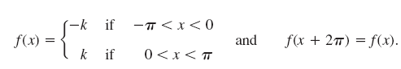
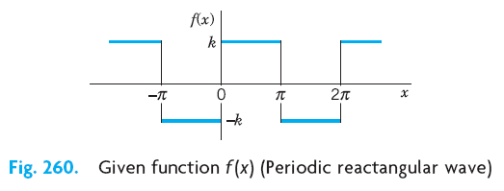
Periodic Wave Equation:
Find the Fourier coefficients of the periodic function
Class work
Cont. to next slide

Slide 11
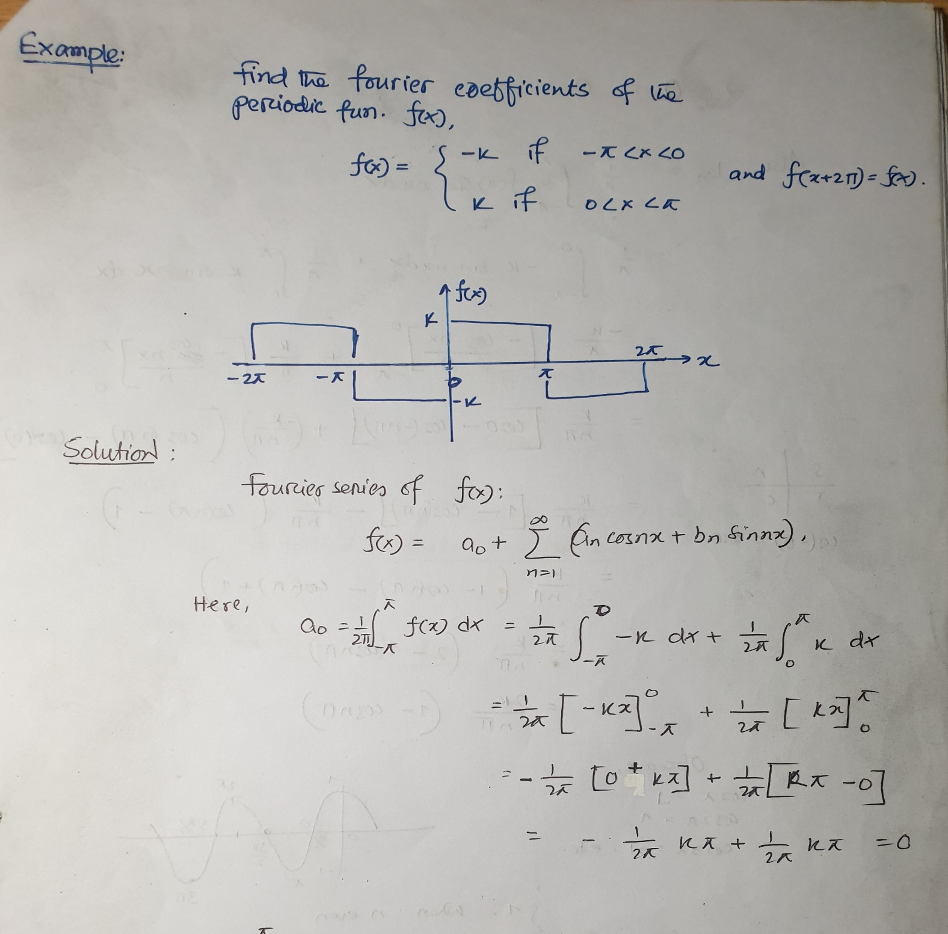
Cont. to next slide

Slide 12
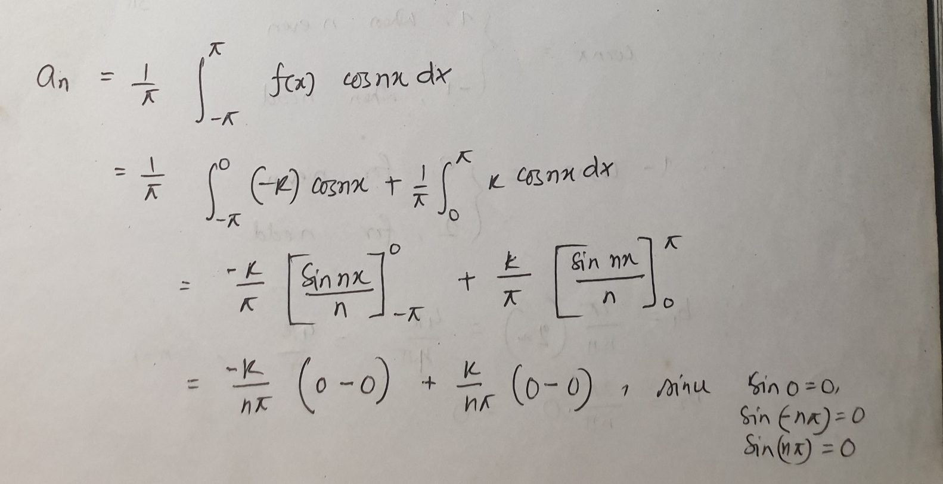
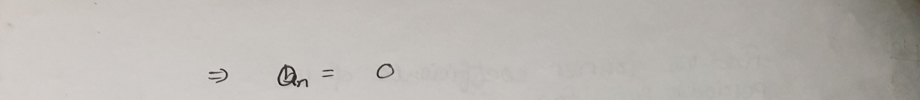
Cont. to next slide

Slide 13

Cont. to next slide

Slide 14

Cont. to next slide

Slide 15
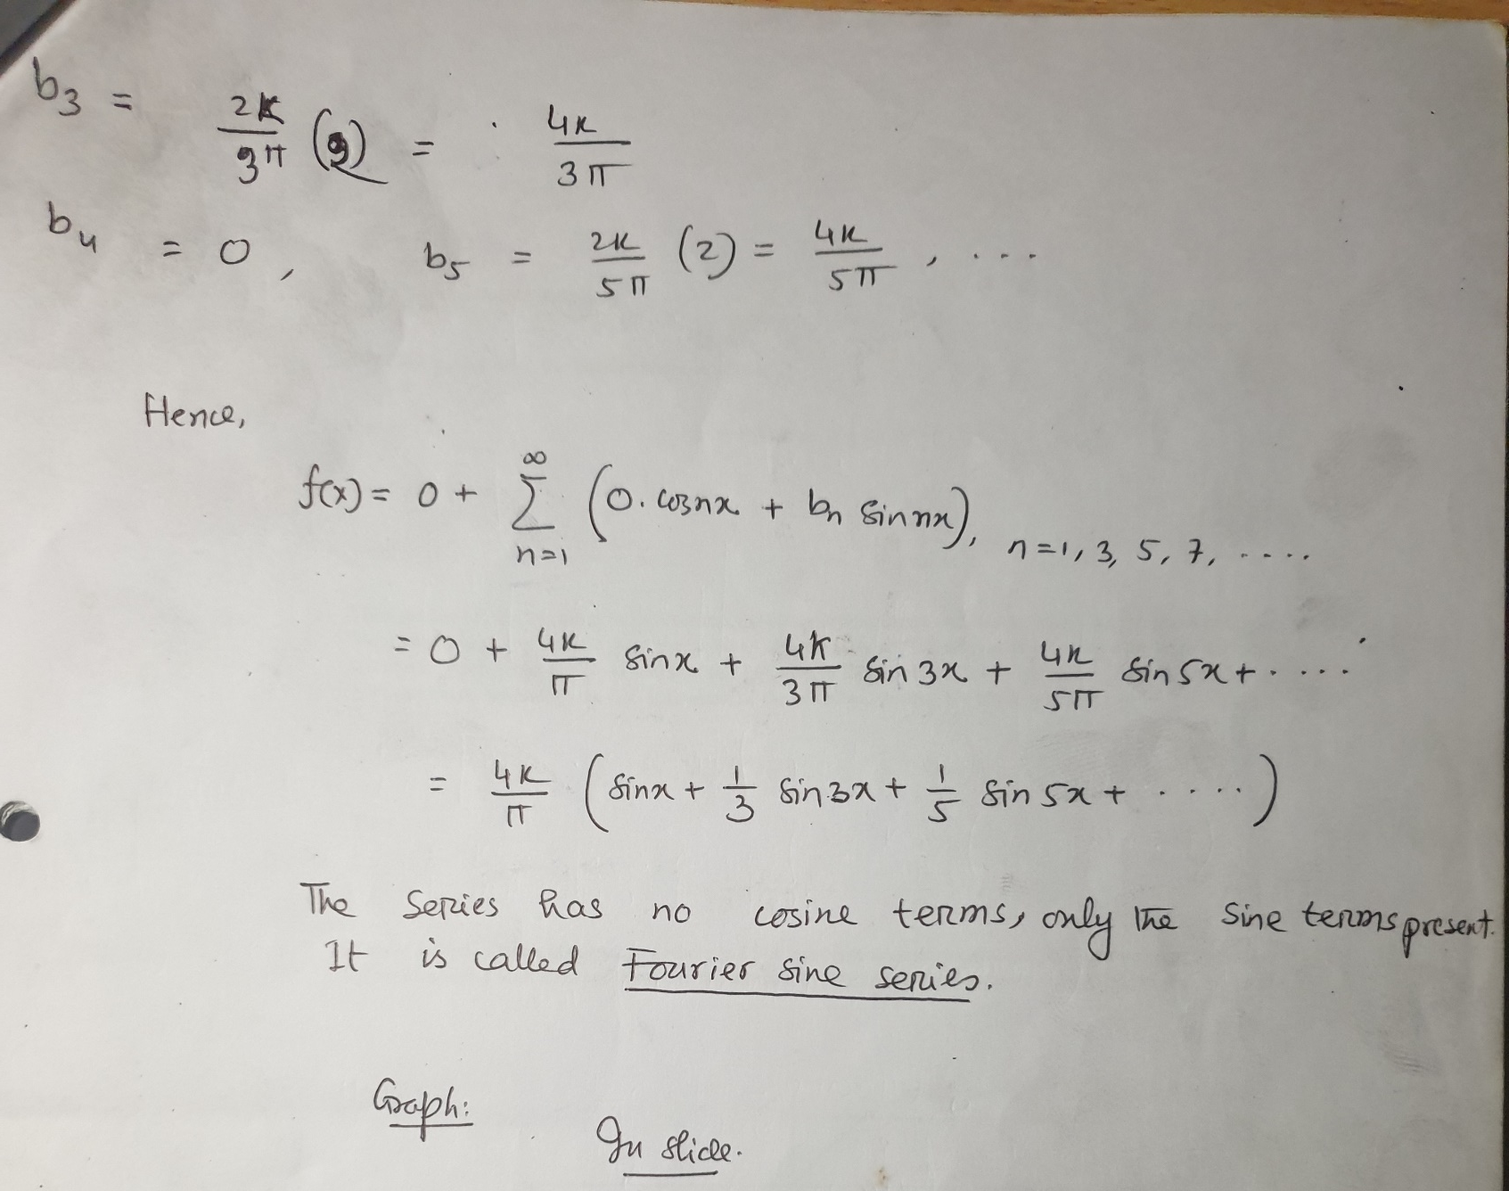
Cont. to next slide

Slide 16
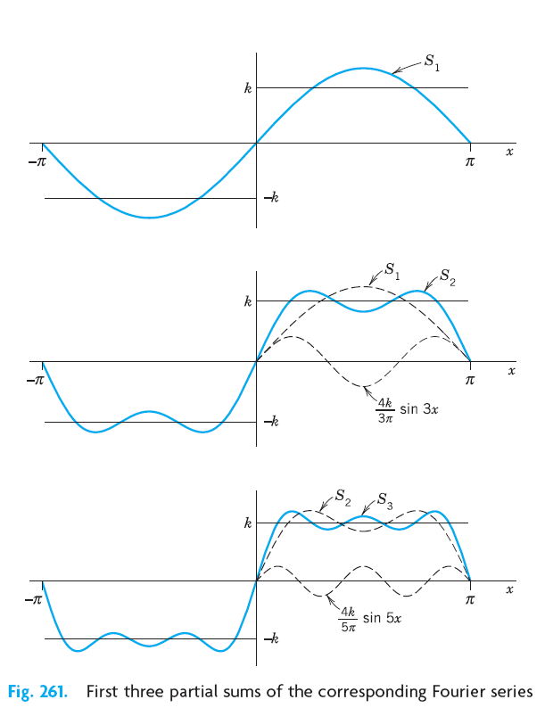

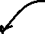

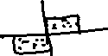


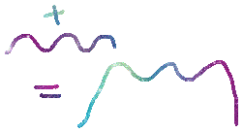
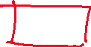
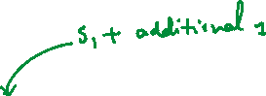
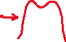


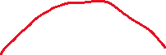
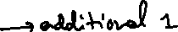

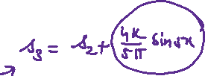
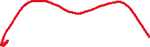


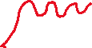


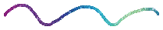
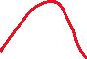

Slide 17
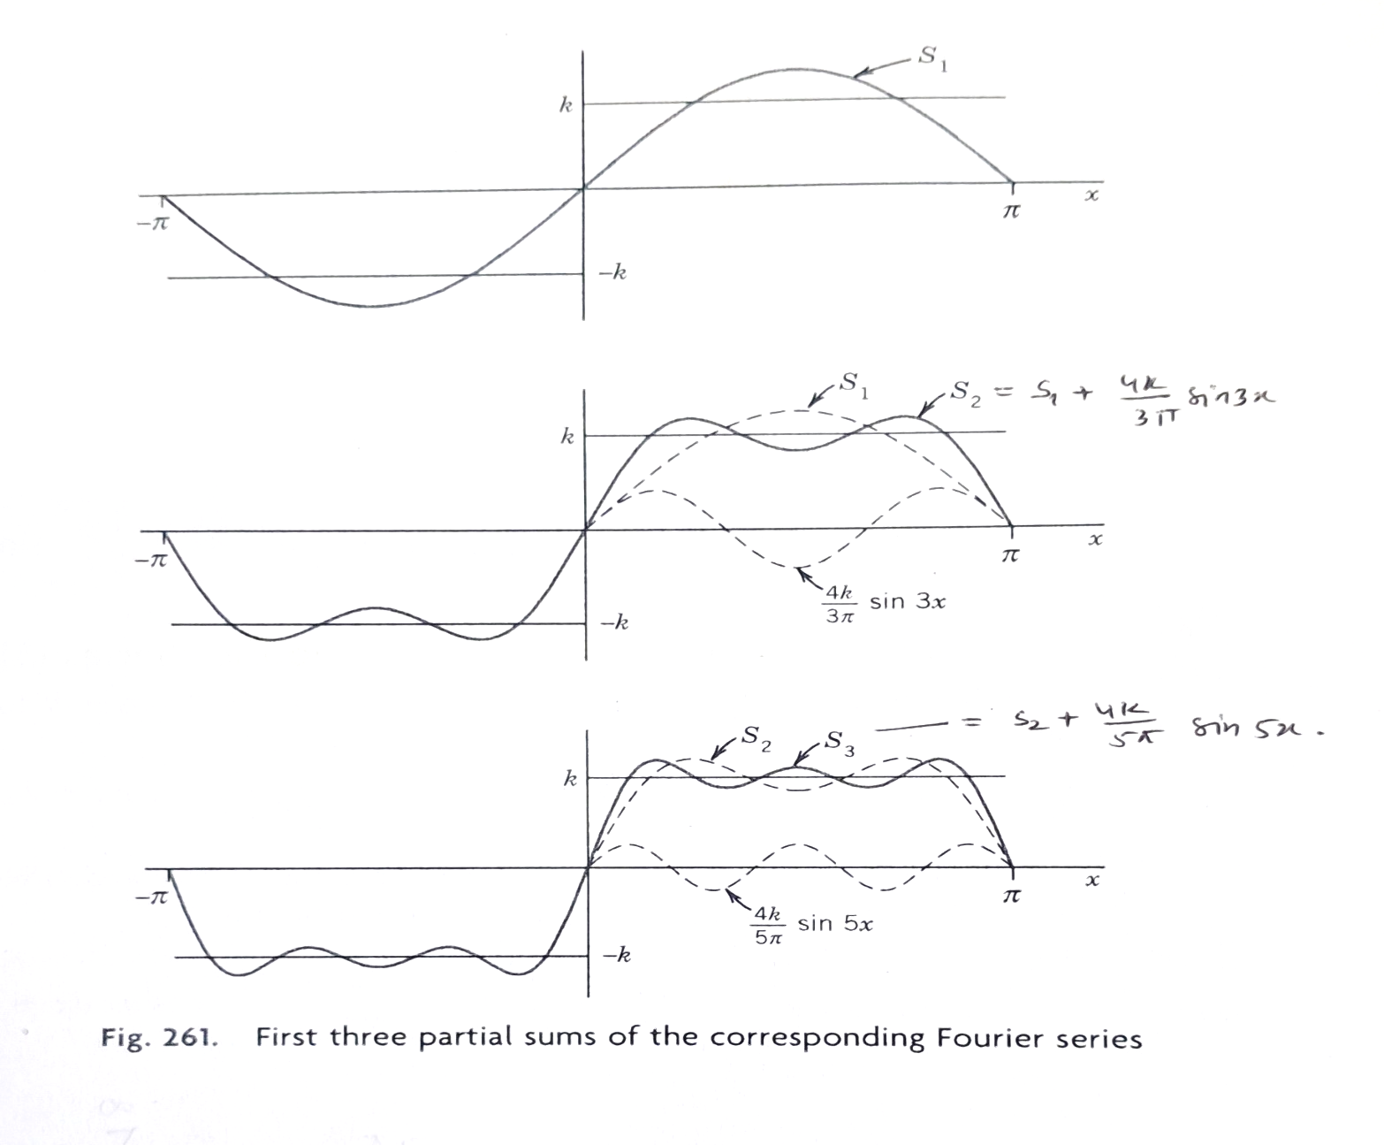
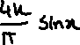

Slide 19
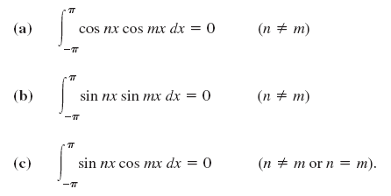
Theorem 1 :
The trigonometric system (2b) is orthogonal on the interval
(
,
that is, the integral of the product of any two functions in (2b) over that interval is 0, so that for any integers n and m,
(6)

Slide 20
Exercise: 11.1
P R O B L E M S E T 11.1
Problem: 9, 10, 14, 15, 18
Page 482 CHAP. 11 Fourier Analysis from Erwin Kreyszig

Slide 21
Review Material to solve exercises of chapter 11.1
H. Anton

Slide 22
Review Material to solve exercises of chapter 11.1
H. Anton
Evalueate

Slide 23
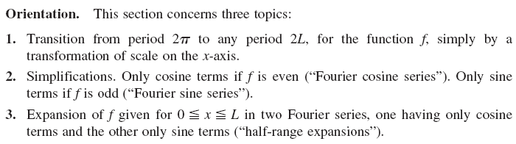
Chapter 11.2
Arbitrary Period. Even and Odd Functions.
Half-Range Expansions

Slide 24
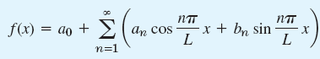
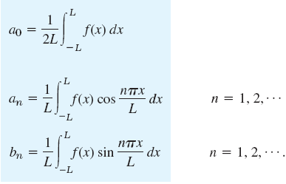
Fourier Series for Arbitrary Period
Fourier series for a function f(x), where the period is not 2π but 2L is
(7)

Slide 25
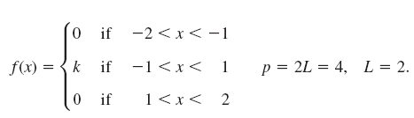
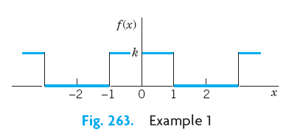

Slide 26
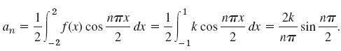




Using relation (7), we obtain
Using relation (7), we also obtain
Hence, the Fourier Series is

Slide 27


Fourier Even and Odd functions
(Fourier Cosine and Sine Series):
,
then the Fourier series (7) reduces to

Slide 28

,
then the Fourier series (7) reduces to
Note

Slide 29



Slide 30


Slide 31
Exercise 11.2
Problem: 9, 11, 13, 24, 26
From Chapter 11.2 Arbitrary Period. Even and Odd Functions. Half-Range Expansions, page 491 of Erwin Kreyszig

Slide 32
Fourier Integral 11.8

Slide 33
Fourier series are powerful tools for problems involving functions that are periodic or are of interest on a finite interval only.
Since, of course, many problems involve functions that are
non-periodic and are of interest on the whole x-axis, we ask what can be done to extend the
method of Fourier series to such functions. This idea will lead to “Fourier integrals.”

Slide 34




Slide 35


Slide 36





Fourier Series:
Fourier Integral:

Slide 37


Slide 38



Slide 39





